Slide 1

DEPARTMENT OF
ARTIFICIAL INTELLIGENCE AND DATA SCIENCE
ACADEMIC YEAR 2025 - 2026
SEMESTER III
ARTIFICIAL INTELLIGENCE LABORATORY
MINI PROJECT REVIEW
<INTELLIGENT RECIPE RECOMMENDER USING CONSTRAINT SATISFACTION PROBLEM>
REGISTER NUMBER | 2117240070256
NAME | RITESH M.S.
YEAR | II
SECTION | E
FACULTY IN-CHARGE | BHAVANI M

Slide 2
PROBLEM STATEMENT
AI Overview: Artificial Intelligence simulates human intelligence for reasoning and decision-making.
CSP Concept: Defines variables, domains, and constraints to find feasible solutions.
Context: People face difficulty in meal planning considering available ingredients, diet, and time.
Problem: Traditional recipe searches ignore such constraints, causing inefficiency and food waste.
Aim: To design an intelligent recipe recommender using CSP that suggests meals based on user constraints.
Expected Output: Ranked recipe list satisfying dietary, time, and difficulty constraints.

Slide 3
THEORETICAL BACKGROUND
CSP Components: Variables (recipes), Domains (attributes), Constraints (diet, time, difficulty).
Constraint Types: Hard – must satisfy (diet, time, skill); Soft – preferences (ingredient match, nutrition).
Algorithms: Backtracking, Forward Checking, Arc Consistency.
Chosen Algorithm: Forward Checking – eliminates invalid recipes early, improving efficiency by ~80%.
Reason: Balances speed, completeness, and transparency.

Slide 4
IMPLEMENTATION AND CODE
Language: Python 3.12
Approach: CSP solver with forward checking.
Recipe Data: Stored as dictionaries with dietary tags, time, difficulty, and nutrition.
List | Git-hub Repository Links
Implementation of Code Link | https://github.com/Ritesh-MS11/Intelligent-Recipe-Recommender-Using-CSP
Word Document Report Link | https://github.com/Ritesh-MS11/Intelligent-Recipe-Recommender-Using-CSP
PPT Link | https://github.com/Ritesh-MS11/Intelligent-Recipe-Recommender-Using-CSP

Slide 5
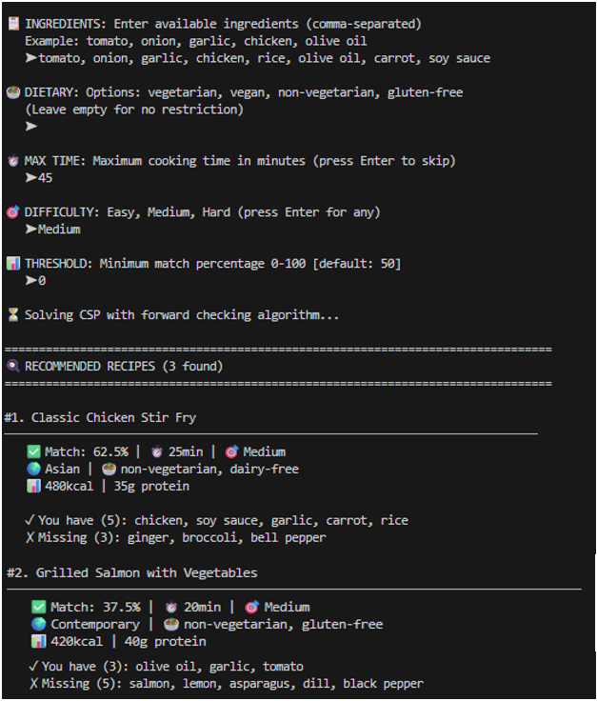
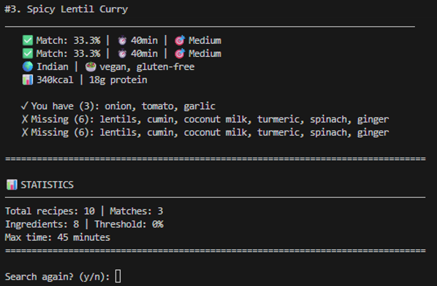
OUTPUT AND RESULTS

Slide 6
OUTPUT AND RESULTS
100% accuracy in hard constraint validation.
Optimal results via multi-criteria ranking.
Linear time complexity (O(n)) for real-time performance.
Handles edge cases (no matches, full matches).
Short Term: Expand recipes, add web app, ingredient substitutions.
Long Term: Machine learning for personalization, nutrition optimization, knowledge graphs, voice interface.

Slide 7
REFERENCES
1. Russell & Norvig (2021) – Artificial Intelligence: A Modern Approach
2. Aberg (2006) – Constraint-Based Meal Planning
3. Tran et al. (2017) – Food Recommender Systems Overview
4. Chen et al. (2021) – Personalized Food Recommendation (WSDM ’21)
5. Pawar et al. (2016) – Forward Checking for Recipe Search
6. Python Documentation (2024)

